Slide 1
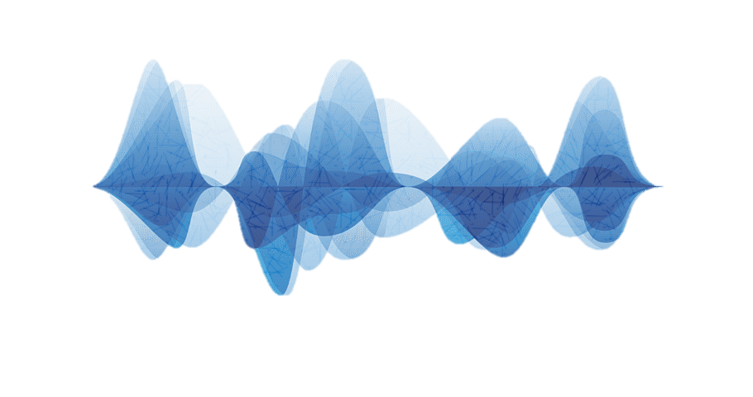
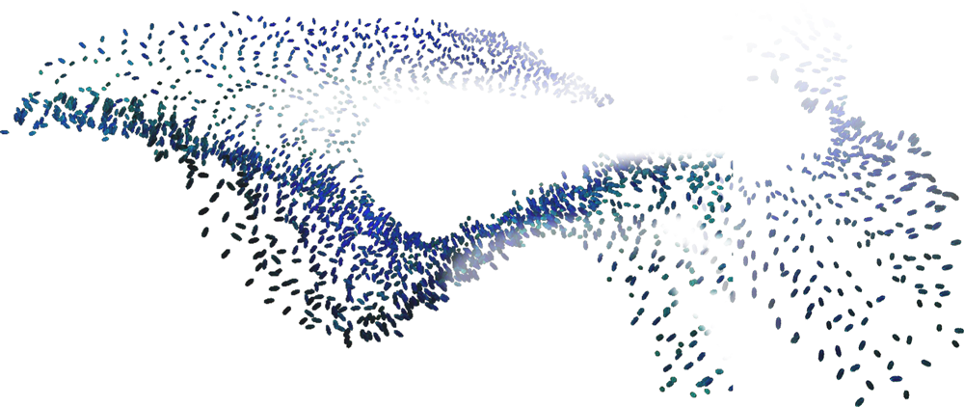
SwarmPlayer: A Swarm-Based Application for Music Visualisation
Name: Basil Regi
Student ID: 1527413
Supervised By: Achim Jung

Slide 2
Project Motivations
Big fan of Music
Music Information Retrieval is a crucial field at the intersection of Music and Computer Science
Curious about the use of visualisations at concerts at festivals
Introduced to the idea of Swarms by Achim
Music Visualisation is an extremely underrated and overlooked field, with very little research conducted on it
Seemed like a unique idea

Slide 3
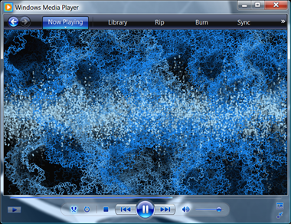
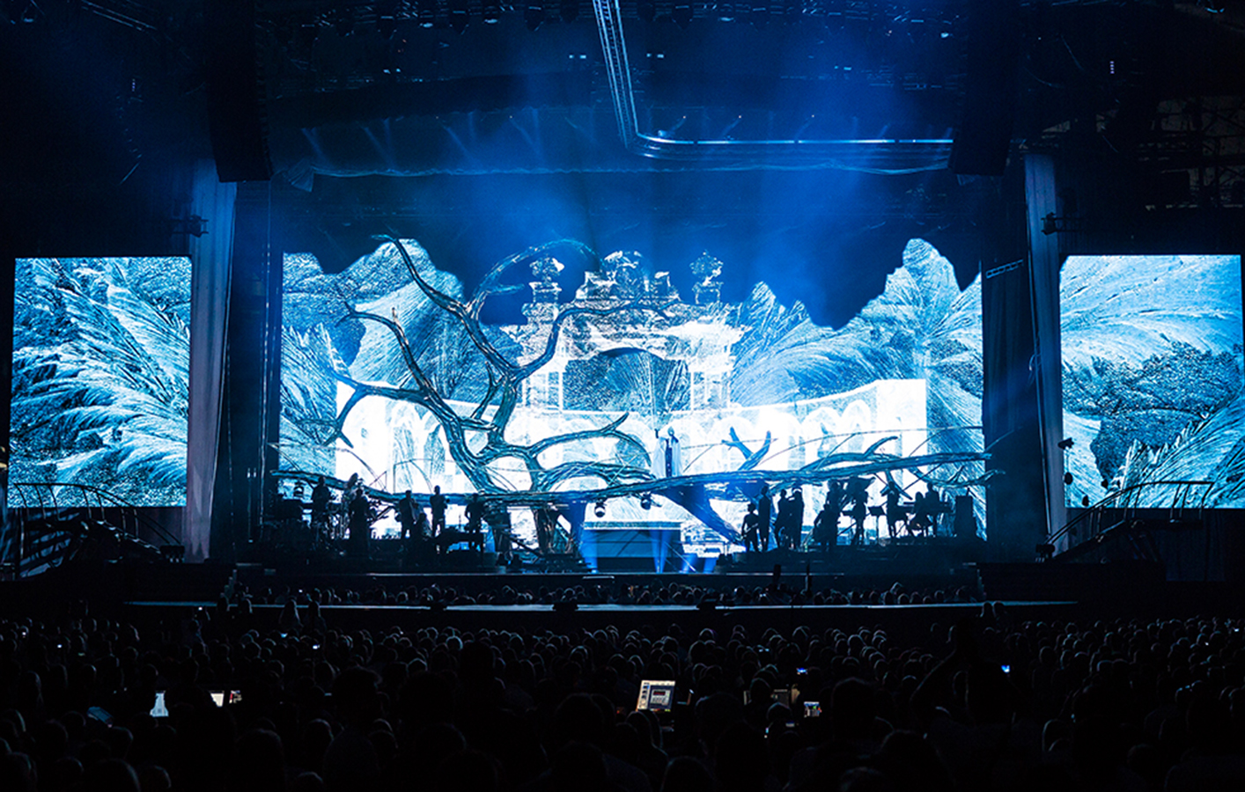
Examples of Music Visualisers
Windows Media Player comes to mind as most common visualiser
Does not reflect the music well and therefore serves no real purpose
An interesting example of the use of visualisers are at concerts and festivals
Usually quite mesmerising, however, they have to be manually created and take a lot of work/effort

Slide 4
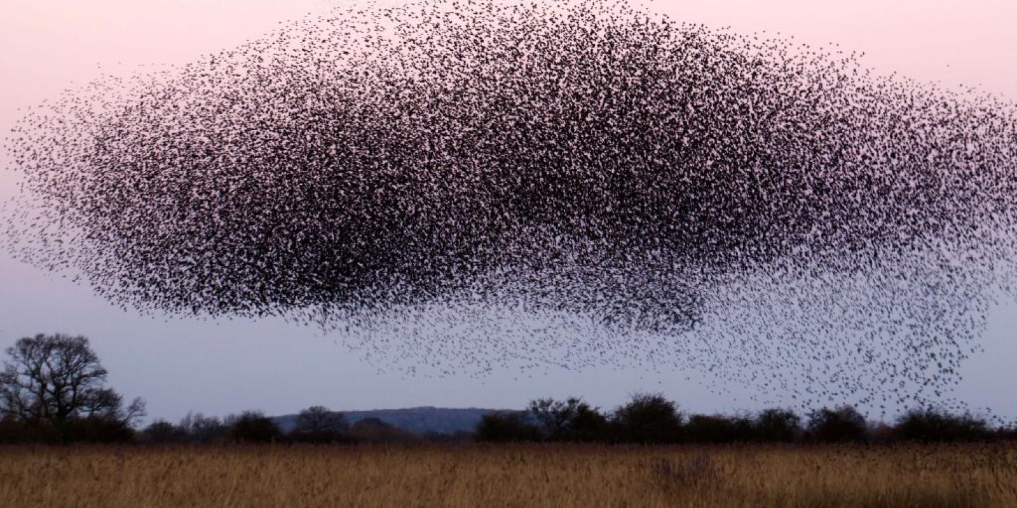
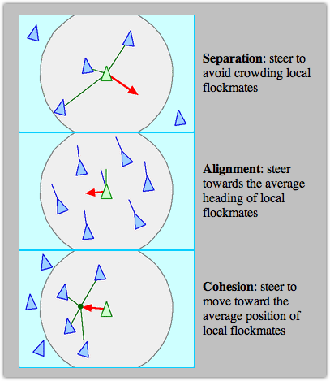
Swarm Behaviour
Swarms are basically large group of living things moving together, this behaviour has been observed in birds, fishes, insects and even in humans.
Reynolds proposes that a swarm can be modelled by attributing 3 behaviours to each member of that swarm
Further research has shown other behaviours that can added to produce a more realistic swarm model, however the above 3 are sufficient to produce an visually interesting model

Slide 5
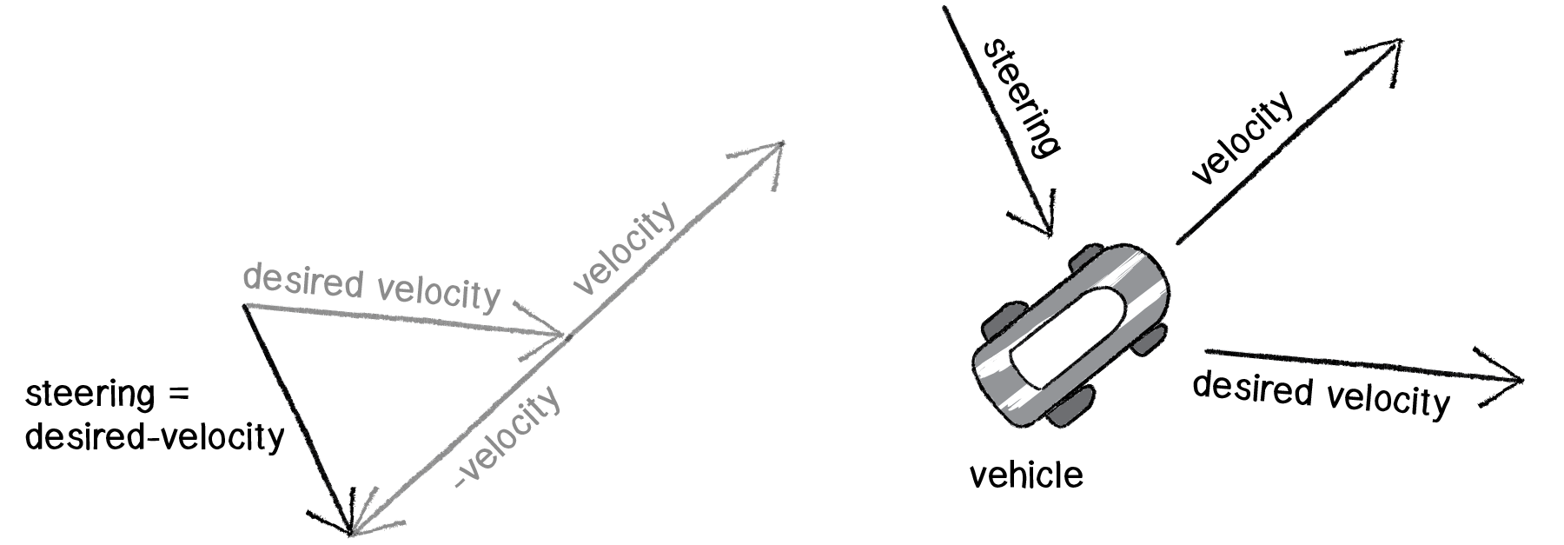
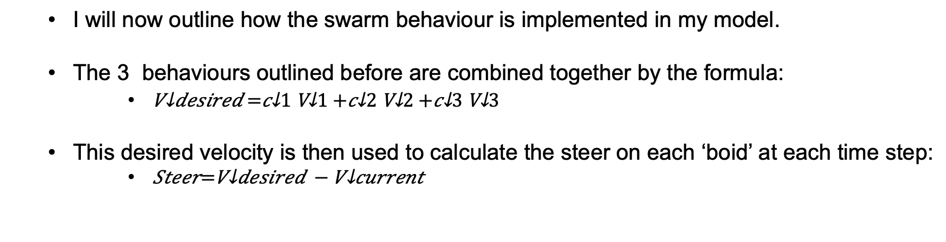
Implementation of Swarm
I will now outline how the swarm behaviour is implemented in my model.
The 3 behaviours outlined before are combined together by the formula:
This desired velocity is then used to calculate the steer on each ‘boid’ at each time step:

Slide 6
Implementation of Swarm
I do not aim for realism in my swarm model
I also do not enforce collision avoidance to a point where collisions never occur
I found that, the right balance between maximum speed and maximum force was required to produce an interesting visualisation
Too high a speed = boids moved too erratically
Too high a force = boids unable to move freely

Slide 7
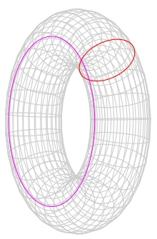
Toroidal World
y
x
y
x
Algorithm Walk-Through
Notes:
One of the biggest difficulties I experienced was to implement the swarm behaviour in a toroidal world.
I wanted to simplify the calculations so modelled the world using a 2D co-ordinate system using x and y values that relate directly to a position on the screen
An interesting extension to my implementation would be to use a 3D system and see how the visualisation would be affected
However, the difficulty when boids were at the edge of the screen, meaning that they would have to affect the boids at the other edges of the screen in a ‘wraparound’ toroidal world.
The first issue was calculating the distance between boids to determine its neighbours:
To get around this problem I first simplified it down so that each dimension is dealt with independently and the distance between boids is calculated in each dimension separately and the lowest value is selected.
In each dimension I then check whether the difference between the boids are less than the maximum width/height of the screen
If no, then no need for wraparound calculation
If yes, then consider the two different cases for which side the target boid is on and add/subtract maximum width/height from the x/y co-ordinate from the boid
The second issue is calculating the direction vector for collision avoidance and swarm centering behaviours. To overcome this issue I use a similar process as above to re-calculate the position vectors of the neighbouring boids to a position that may extend the screen and then calculate the direction to it.
The actual wrap-around is the finally done before the boids are painted, a check is done to check whether the position of each boid goes outside of the defined edges and then the co-ordinates are readjusted before painting the boid

Slide 8
Audio Feature Extraction
Finding good algorithms for feature extraction is research project in it’s own right
Aim is to find lightweight algorithms which I can implement in Java to be integrated into the swarm visualisation
Focussed on Beat Detection as it is easily understood by viewers with no musical background
Pitch and Key not so easily understood
Simon Dixon’s beat detection algorithm (BeatRoot) seemed like the ideal option

Slide 9
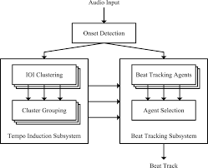
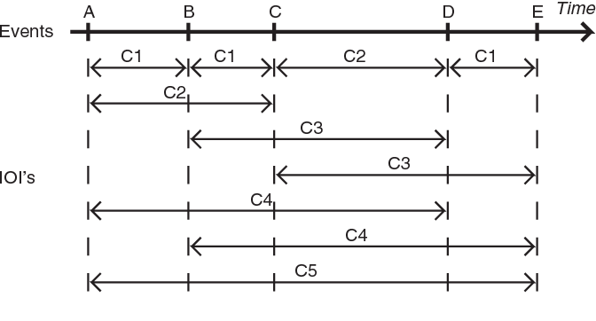
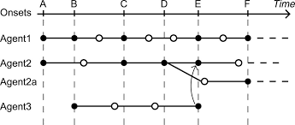
BeatRoot Algorithm
There are two phases to the algorithm
Peak Finding
Tempo Induction

Slide 10
Pre vs On-line Processing
An important consideration that I had to make was whether to use pre-processing for the audio files or process them in real-time.
Decided on using pre-processing
BeatRoot algorithm is an example of pre-processing
However pre-processing the audio file meant that I had to figure out how I was going to synchronise the audio with the visualisation

Slide 11
Rendering Model
Audio File
Audio Processor
Tempo + Beat Array
Event Timer
Boid World Model
Beat Time/Salience
Update Visualisation
Update World Model

Slide 12
SwarmPlayer Demo

